Slide 1

M/WBE Compliance
Tools for Non-For-Profit Grantees
Presented by the Office of Economic Opportunity and Partnership Development
in collaboration with
Affordable Housing Corporation
New York State Rural Housing Coalition, Inc.
New York State Rural Advocates

Slide 2
Regulations

Slide 3

Governing Regulations
NYS Executive Law Article 15-A
5 NYCRR Parts 142-144 for All State Contracts
Signed into law to promote employment and business opportunities on State contracts for minority and women-owned businesses.
(1) in excess of $25,000 for labor, services, equipment, materials or any combination.
(2) in excess of $100,000 for real property renovations and construction

Slide 4
Grantee Compliance Requirements
Maintain centralized records on participating MBEs and WBEs
Document dollar amount of contract/subcontracts awarded to MBEs and WBEs
Report quarterly to HCR’s Office of Economic Opportunity & Partnership Development (OEOPD)
On the 5th day of the month following the end of each quarter:
Quarter | Reporting Period (Payments Made) | Due Date
1st | April 1-June 30 | July 5th
2nd | July 1-September 30 | October 5th
3rd | October 1-December 31 | January 5th
4th | January 1-March 31 | April 5th

Slide 5
Applying the MWBE Goal
Start with the AHC grant awarded
Deduct administrative costs (if applicable)
  Up to 10%
Deduct acquisition costs (if applicable)
  Up to 49%
Apply MWBE goal to remaining awarded funds used for construction related hard and/or soft costs

Slide 6
Compliance
Forms

Slide 7
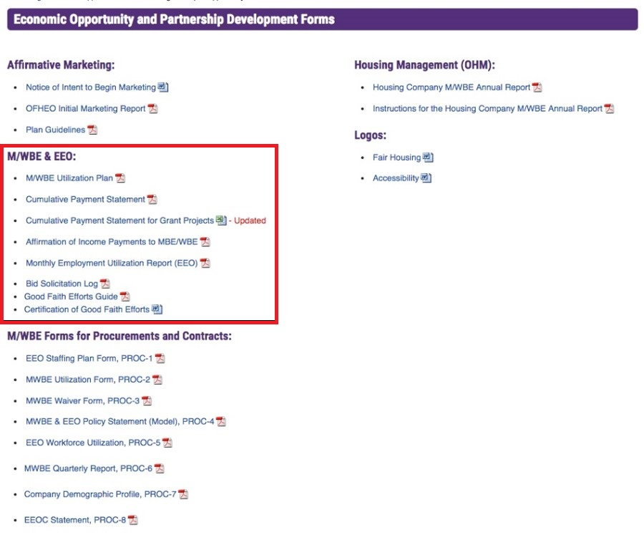

Please visit our website for the required compliance forms.
Click here for our forms

Slide 8
M/WBE Utilization Plan
Shows the projected use of New York State certified MWBEs
Must reflect M/WBE utilization up to the required dollar amounts
New applicants must submit a preliminary plan before the funding award is approved to move forward into contracting. Existing projects must submit an approved utilization plan, if one was not submitted prior
Home Improvement Grantees must identify a pool of contractors including MWBEs for the home owners to choose from. This pool of contractors should be listed on the utilization plan, with estimated cost. By establishing a pool of qualified and certified firms, this will help in completing a Good Faith Effort package at the end of the project.
Amended plans will be accepted

Slide 9
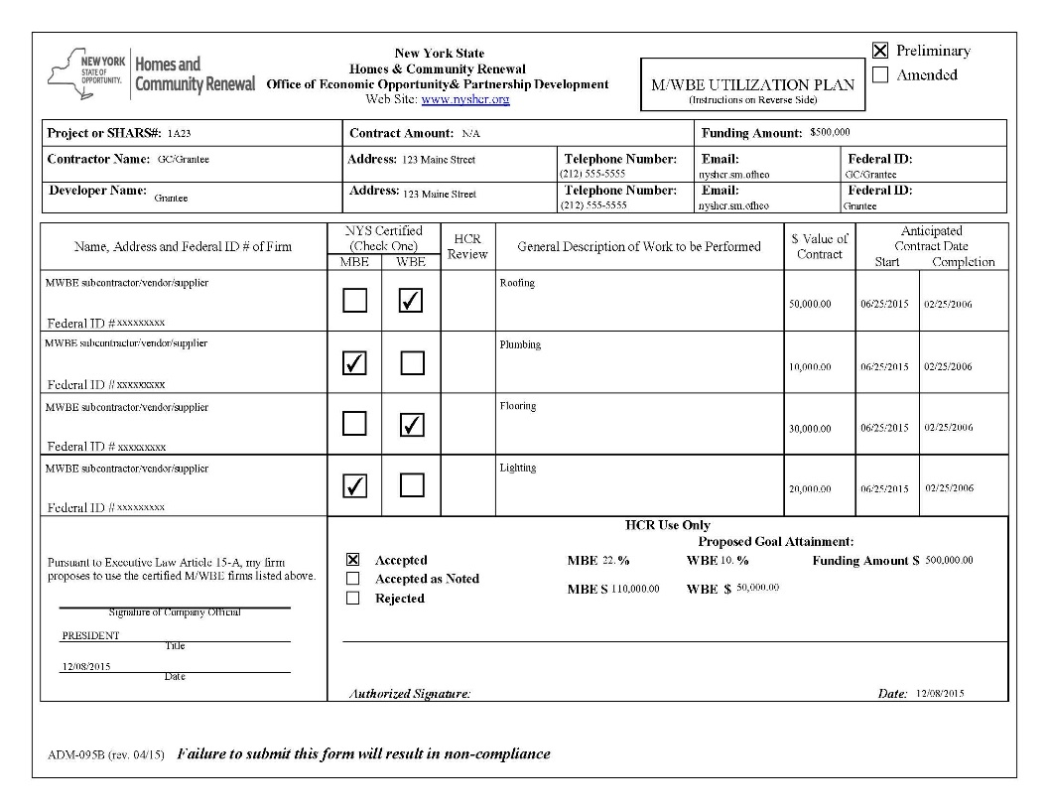

Slide 10
Cumulative Payment Statement
Details payments to all subcontractors working on the project
Report MBEs, WBEs, and non-MWBEs (subcontractors not qualified as a certified MBE or WBE “everyone else”)
Indicate “No Activity” if there are no payments for the reporting period
Required every quarter for the duration of the project

Slide 11
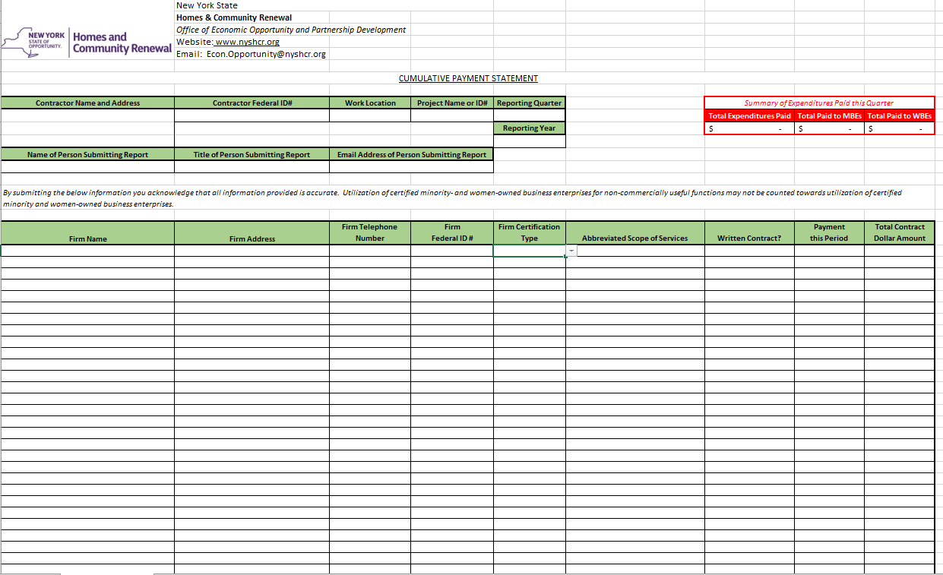

Slide 12

Affirmation of Income Payment Statement
Confirms payment to certified M/WBE subcontractor
Required for each MBE and WBE payment listed on the Cumulative Payment Statement
Line 5b. must match the payment amount indicated on the Cumulative Payment Statement
Must be signed by both the subcontractor and the grantee

Slide 13
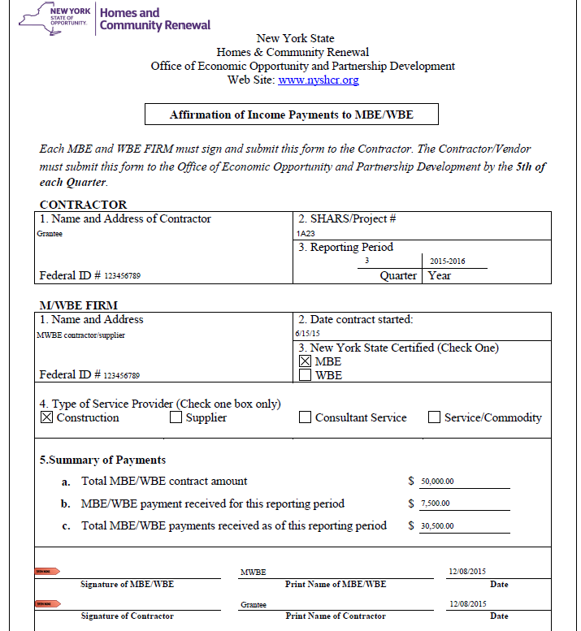

Slide 14
Good Faith Efforts

Slide 15
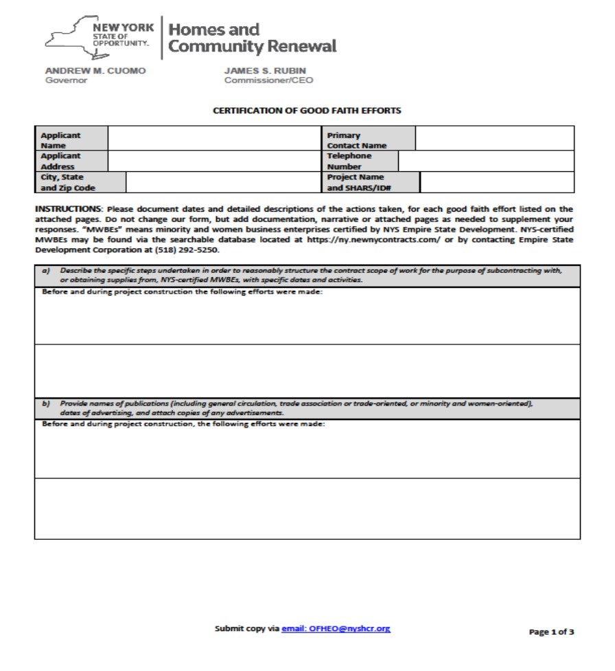
What is the Certification of Good Faith Efforts (GFE)
Who submits a GFE
When to submit a GFE
Where to obtain a GFE
The GFE should include:
  All certified and non-certified MWBE firms utilized during the project. Construction related trades and non-construction related trades offering professional services are acceptable.
  All marketing efforts to reach minority and/or women owned businesses.
  All bidding efforts to utilize minority and/or women owned businesses.
  All outreach to increase minority and/or women workforce.

Slide 16
GFE Marketing Efforts
Solicit in writing a reasonable number of NYS-certified MWBEs.
Attend MWBE conferences/events.
Advertise in general circulation, trade associations, MWBE publications or newsletters.
Sponsor business opportunity-related meetings, conferences, seminars with minority organizations.

Slide 17
GFE Marketing Efforts
Post notices in common areas of housing developments, public housing authority buildings, schools, daycare facilities.
Utilize local media, electronic and print, to promote contract and business opportunities for MBEs and WBEs.
Internet
  Social Media - Facebook, Twitter.

Slide 18
GFE Marketing Efforts
Place outreach material at movie theaters that provide for free public service announcements.
Partner with faith-based and community organizations that serve the minority population.
Conduct outreach activities at adult-education training centers or other community activity classes.

Slide 19
Waivers

Slide 20
Waivers
How to secure a waiver
When to request a waiver
Who approves the waivers
How long is the approval process
Programs that have successfully secured waivers
  Down payment and closing cost assistance
  Manufactured home repair
  Home Improvement
  Projects that have not met their MWBE goal
  Gap Financing

Slide 21
Gap Financing
What is gap financing
How to secure a waiver for gap financing
When to request a waiver for gap financing

Slide 22
Home Improvement
Securing a waiver for home improvement
  Prepare a GFE
  Include a copy of your utilization plan
  Attach all efforts to meet the MWBE goal

Slide 23
Participation Goals

Slide 24
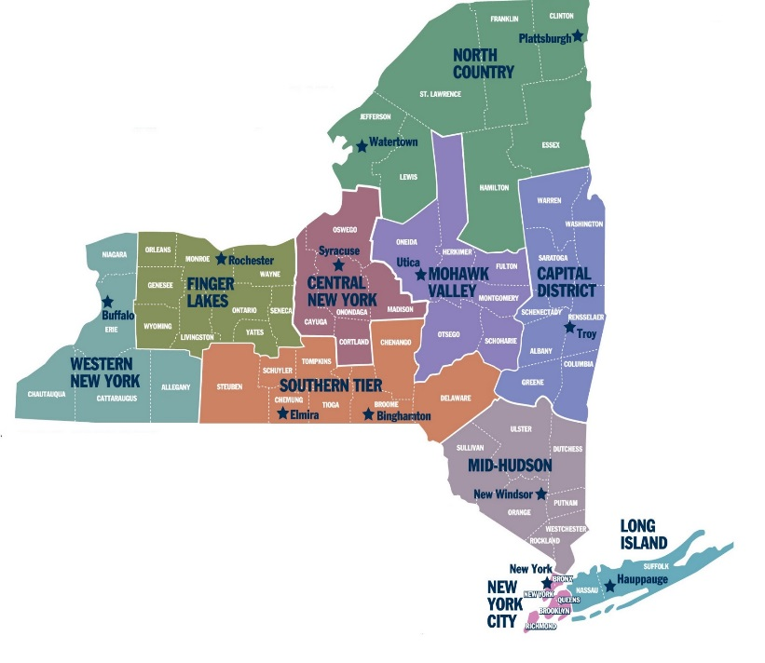
NYS Regional Map
Region 1 Western New York: Allegany, Cattaraugus, Chautauqua, Erie, Niagara
Region 2 Finger Lakes: Genesee, Livingston, Monroe, Ontario, Orleans, Seneca, Wayne, Wyoming, Yates
Region 3 Central New York: Cayuga, Cortland, Madison, Onondaga, Oswego
Region 4 Southern Tier: Broome, Chemung, Chenango, Delaware, Schuyler, Steuben, Tioga, Tompkins
Region 5 Mohawk Valley: Fulton, Herkimer, Montgomery, Oneida, Otsego, Schoharie
Region 6 Capital Region: Albany, Columbia, Greene, Rensselaer, Saratoga, Schenectady, Warren, Washington
Region 7 North Country: Clinton, Essex, Franklin, Hamilton, Jefferson, Lewis, St. Lawrence
Region 8 Mid-Hudson: Dutchess, Orange, Putnam, Rockland, Sullivan, Ulster, Westchester
Region 9 Long Island: Nassau, Suffolk
Region 10 New York City: Bronx, Kings, New York, Queens, Richmond

Slide 25
MBE/WBE Participation Goals by County
Counties |  |  | MBE | WBE
Nassau Bronx Kings New York | Orange Putnam Queens Richmond | Rockland Suffolk Westchester | 22% | 10%
Erie Genesee Livingston | Monroe Niagara Orleans | Ontario Wayne | 20% | 10%
Albany Broome Cayuga Dutchess Herkimer | Montgomery Madison Oneida Onondaga Oswego | Rensselaer Saratoga Schenectady Schoharie Tioga | 20% | 10%
Allegany Cattaraugus Chautauqua Chemung Chenango Clinton Columbia Cortland Delaware Essex | Franklin Fulton Greene Hamilton Jefferson Lewis Otsego Schuyler Seneca | St. Lawrence Steuben Sullivan Tompkins Ulster Warren Washington Wyoming Yates | 10% | 10%
MWBE goals have been established based on availability within the county. The MWBE participation goals relate to the state certified minority and/or women owned business enterprises working on the projects statewide

Slide 26
Resources

Slide 27
New York State Empire State Development (ESD)
Division of Minority and Women Business Development (DMWBD)
All certification questions should be directed to ESD
Maintains directory of certified Minority and Women-Owned businesses in New York https://ny.newnycontracts.com/FrontEnd/VendorSearchPublic.asp?TN=ny&XID=4687
Assist your organization in certification http://www.esd.ny.gov/MWBE/Certification.html

Slide 28
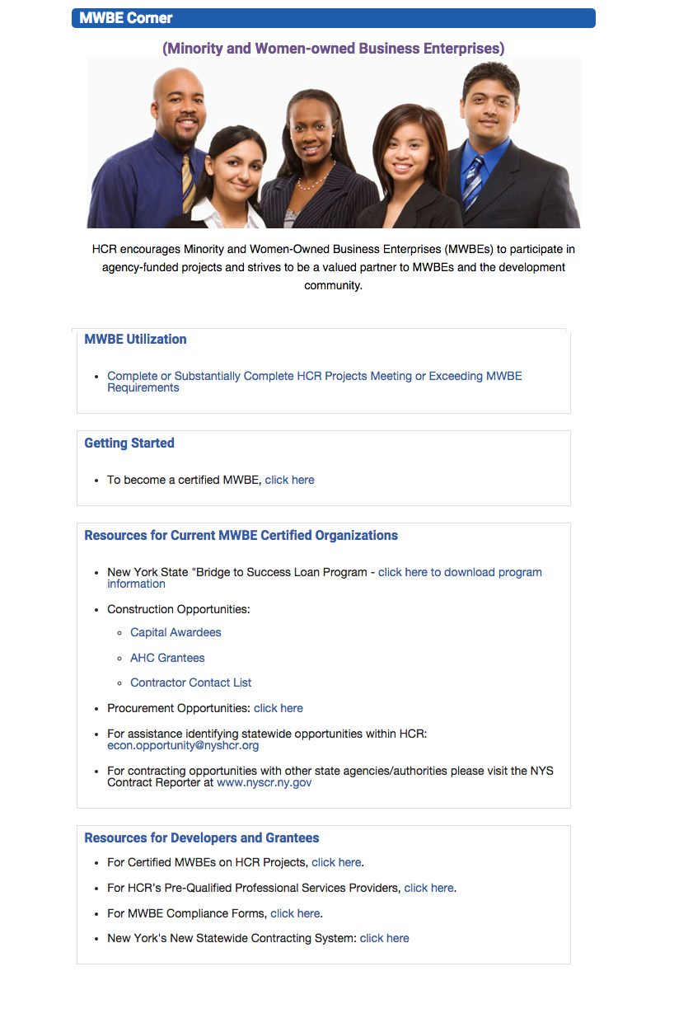


Slide 29
Compliance Specialists
Tameika Edwards
Tameika.Edwards@nyshcr.org
(212) 872 – 0359
Region 10
Lisa Rambaran
Lisa.Rambaran@nyshcr.org
(212) 872 – 0340
Region 1-9
Terry Owens
Terry.Owens@nyshcr.org
(518) 485 – 1935

Slide 30
Questions/Comments
Thank you for your support and commitment to increasing MWBE participation.
Please submit all questions and/or comments to the Office of Economic Opportunity and Partnership Development at
Econ.Opportunity@nyshcr.org
All questions and answers will be posted on the MWBE Corner within the next 10 days

